Slide 1

Plan your Trips, Feel and go deeper in your travels.
Planyts APP
Michele La Malva Moreno
Electronic Systems Engineering student

Slide 2
Knowing our users
Persona:
Manolo is a 25-year-old Engineer who has travelled a lot of times around Europe. He lives in Málaga. He likes walk and discover the places he visits but he finds all touristics guides and online services doesn’t fit its requirements. He would like know all unvisited places and not so busy places around a city, like a local do.
Scenario:
Antonio is planning a little trip to Rome the following 2 weeks. He was in Rome the last year and he has visited almost all monuments and well-know places, like Spagna or Popolo. He would like contact a local guide to go places also he wants go for a party one night to a pub so Antonio receive a well-guided tour via Planyts by contacting a local person who lives in Rome, suggesting pubs and places where he would be fine.

Slide 3
Knowing our users
Age | 15 – 40
Gender | Any
Job titles | Any – High-Medium qualifications jobs
Education | Medium-High level school
Location | Any
Economy | Medium
Passions | Travelling, sociable and bloggers

Slide 4
Development Roadmap
Product wished by our customers (survey based), mockup and user feedback on the idea
Requirement Analysis
First Mockup using Computer Aided design (Prototype 1)
Milestone 1
Heuristic Evaluation, HTA & STN (Prototype 2)
Milestone 2
Prototype 1 reviewed with controlled experiments and Interviews
Milestone 3
Final product

Slide 5
Competitors
 | TripAdvisor | Airbnb | Social nets | Planyts
Social-based score system
Free
Experts on the field
Personalized guide
Experience focused

Slide 6
Requirement Analysis

Slide 7
Requirement Analysis

Slide 8
Requirement Analysis
Derived from the Analysis – Users
We want users who is young, ranging from 18 to 35 years.
They can economic afford travels around the world with a modest bucket.
Users who stay more than 5 days into its destination, because all touristic places have been visited and they start searching for non-touristic places.
Users should be used to mobile applications, that’s why the objetive public is 18 to 35.
Young users who take advices from internet are potentially our customers.
Conclusion
Our application can be a mobile application or even a website-based portal.
We will show designers and travellers ordered by ranking or popularity
Users can search designer, traveller, member or events by a search engine.
Users want quickly get its trip planned so easy-interaction means more positive feedback.

Slide 9
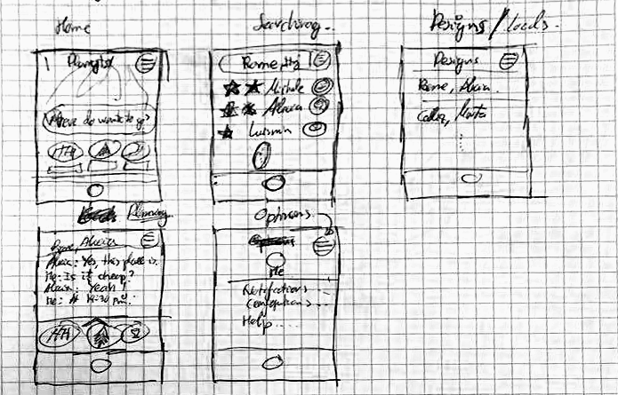
Mock-ups

Slide 10
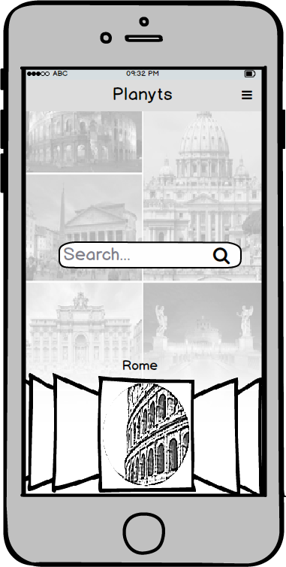
Prototype 1 : Main Features
Home page:
Users can search via a search bar (Name of the city, designer, traveller or events).
Most visited and known places at the bottom
Menu icon at the top-right, showing basic options

Slide 11
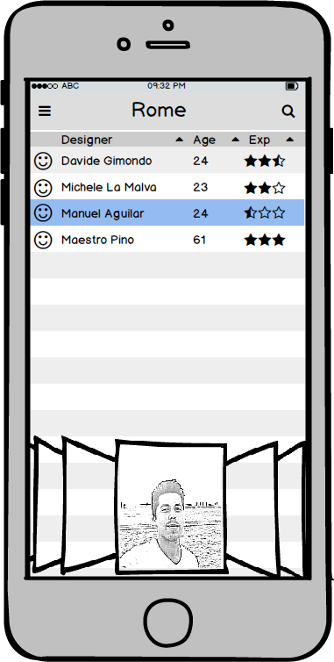
Prototype 1 : Main Features
Search page:
Users can search to a specific designer by top-right search button.
Designers can be ordered by age, social-based scored and alphabetical.
Profile image of the selected designer is displayed at the bottom
Option button is displayed at the left-top side.

Slide 12
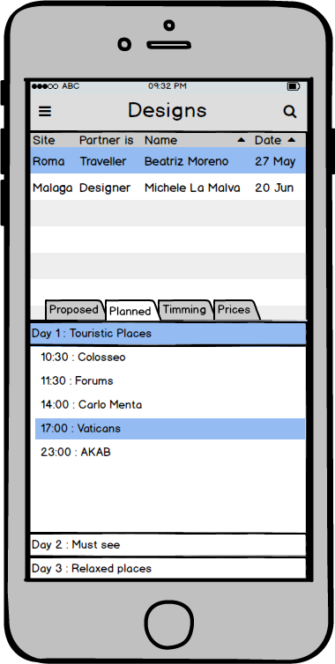
Prototype 1 : Main Features
Designs / Travellers page:
Users can search to a specific designer by top-right search button.
Designers can be ordered by age, social-based scored and alphabetical.
Users can see the current status of the planned trip, as well as the proposed, the planned, timmings and prices of the trip.
Data information is displayed in the bottom page.

Slide 13
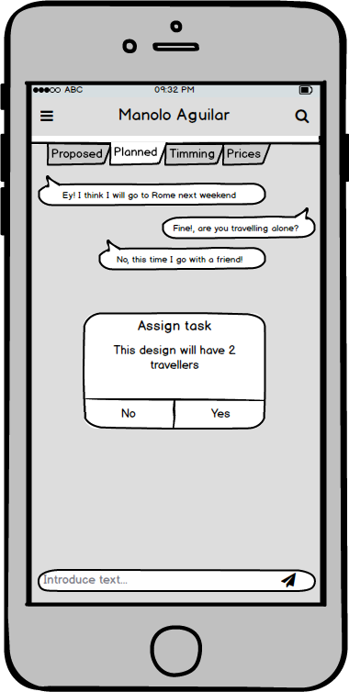
Prototype 1 : Main Features
Chat page :
Planned tasks can be visited at the top side.
Users can chat with designers/travellers via simple chat (like whatsapp)
Confirmation warning about some data for the planned trip.

Slide 14
Heuristic Evaluation
Usability Heuristics for User Interface Design
Visibility of system status
Match between system and the real world
User control and freedom
Consistency and standards
Error prevention
Recognition rather than recall
Flexibility and efficiency of use
Aesthetic and minimalist design
Help users recognize, diagnose, and recover from errors
Help and documentation

Slide 15
Heuristic Evaluation
Violated Heuristics Evaluation for User Interface Design
Visibility of system status
Users don’t see where they actually are (Home page or chat).
There is no icon to switch between home to design page!
User control and freedom & Consistency and standards
It’s not clear if the “menu” option is for “exit” option as well.
Tabs is changed sometimes to bottom from top (or viceversa), this leads to confusion.
There is no a “back” button or “exit” button.
Error prevention
There is no confirmation messages anywhere, better put popup warnings.
Aesthetic and minimalist design
Design shouldn’t looks beautiful with the current proposed layout.
Help users recognize, diagnose, and recover from errors
Because there is no error messages, this is fixed as long as Error prevention tip is covered.

Slide 16
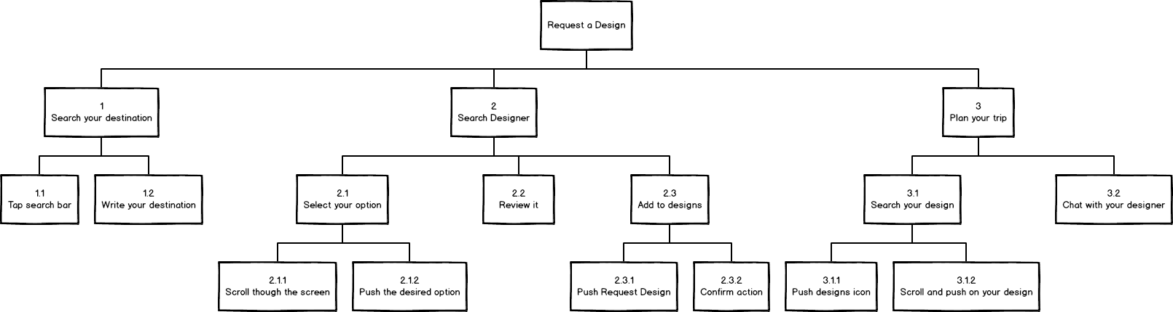
Hierarchical Task Analysis (HTA)

Slide 17
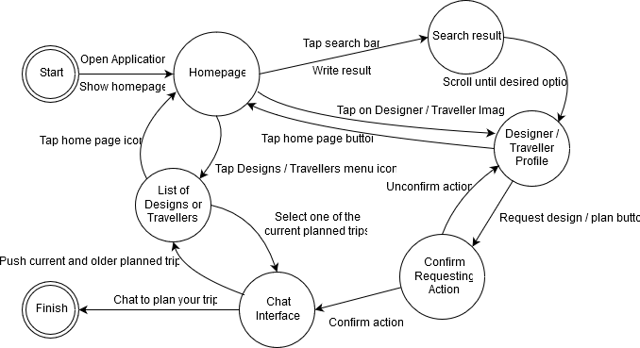
State Transition Network (STN)

Slide 18
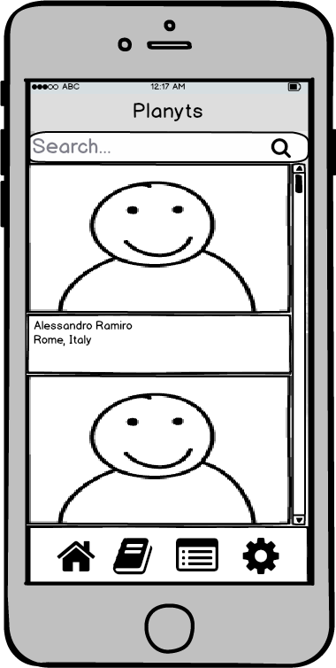
Milestone 2: Prototype 2
Home page:
Added static bottom icons (colored when selected)
Scrolling system which images and elements are pushed down or up like Instagram.
Search bar in top instead of the center

Slide 19
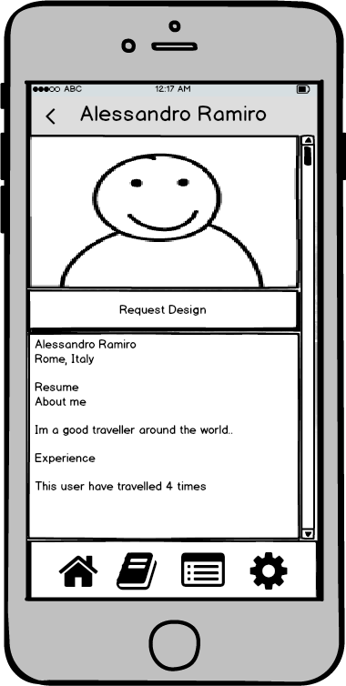
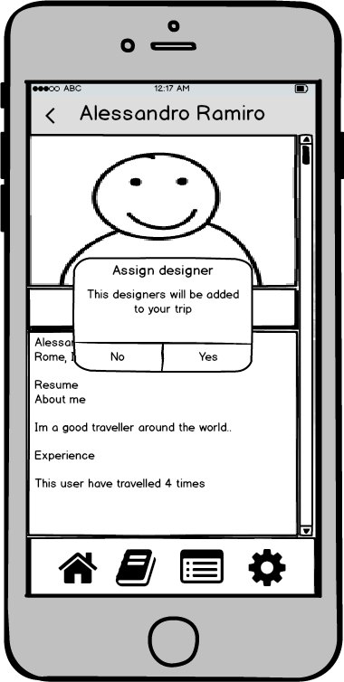
Milestone 2: Prototype 2
User page:
Added back or exit button in top-left side
More and clear information for the user
Advices and error warning information
Buttons and icons do not change its position when scrolled down or up.
User name in the top

Slide 20
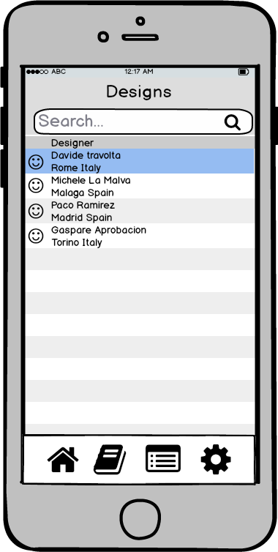
Milestone 2: Prototype 2
Designs / Travellers page:
Added static search button.
Less information means more easy and usability
Deleted trip information (this is encapsulated into chat page)

Slide 21
Milestone 3: Controlled Experiment
Variables to test:
• Independent: different UI style (two interface versions)
• Dependent: total of seconds passed to perfom the “Request a design” task
Hypothesis to test:
- Our hypothesis: Users will take less time to perform the task using application with Interface VersionB than Interface VersionA
- Null Hypothesis: There will be no difference between using application with Interface VersionB and Interface VersionA
Participants:
• Groups of 7 users (4 young persons, 3 adults)

Slide 22
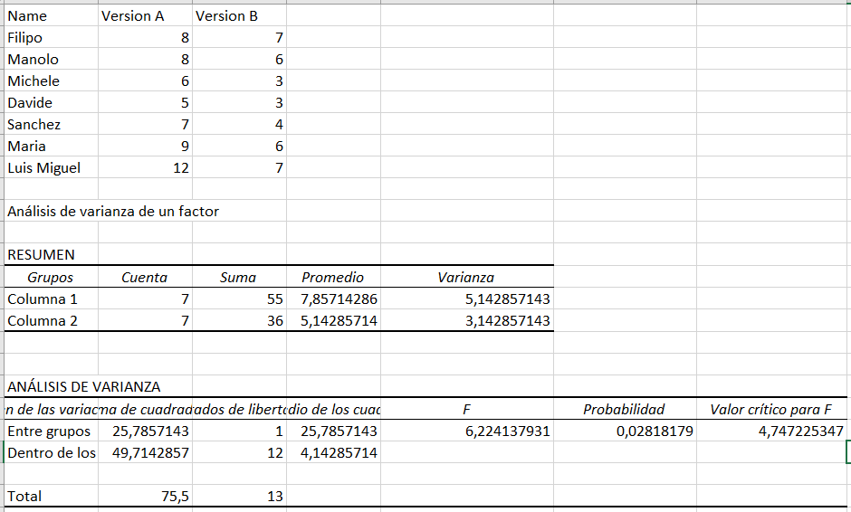
Milestone 3: Controlled Experiment
Conclusion: if F > F crit, we reject the null hypothesis.
Therefore, we reject the null hypothesis and take our hypothesis as valid.
“Users will take less time to perform the task using application with Interface VersionB than Interface VersionA”

Slide 23
Interviews
5 users interviewed (with think aloud - cooperative evaluation)
Task: Search for a Designer.
A summary of the comments:
• I find scroll bar useless, intuitively you simply scroll it down with your fingers!
• Icons should be reviewed, they mean nothing sometimes for the user.
• More minimalist design of the interface.

Slide 24
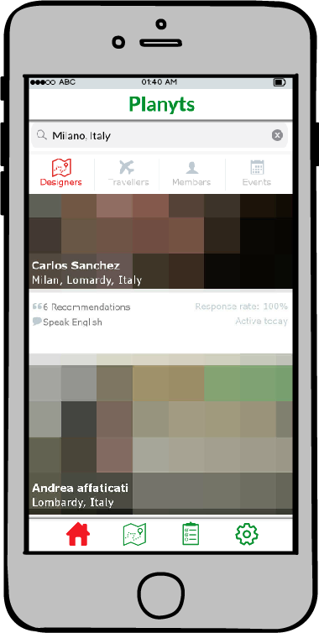
Final product
Home page:
Added Social-based score and basic information about the product (Designer / Traveller)
More friendly UI-style
Colored bottom icons when selected page
Added more options to search engine (Designers, Travellers, members and Events)
Deleted scroll bar

Slide 25
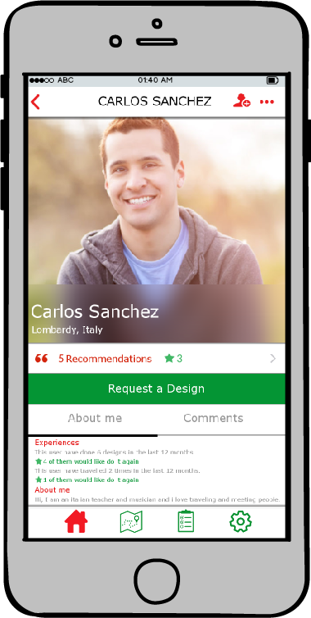
Final product
Product (Designer/Traveller) page:
Added Social-based score information
Added About me and Comments tabs
More optional information in the bottom page

Slide 26
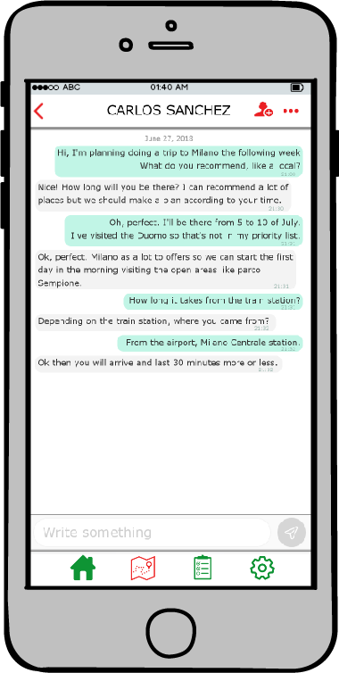
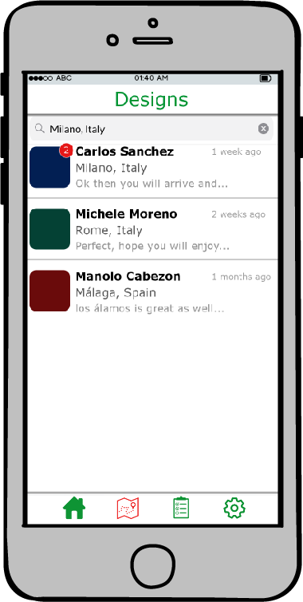
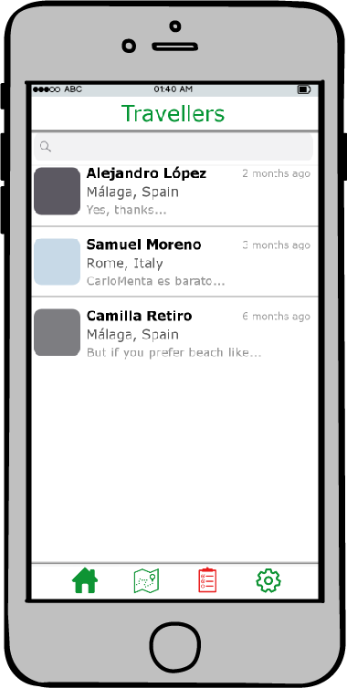
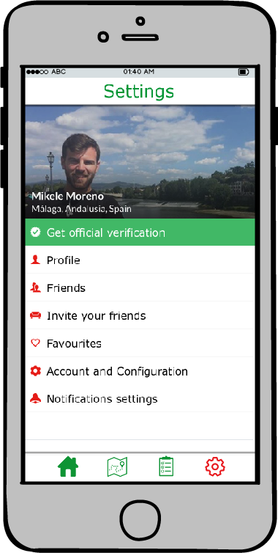
Final product

Slide 27
Future Work
Implement the APP for Android or iOS devices
Connect all data with Planyts.com website database
(Both will have a bunch of technical task not covered by this course.)

Slide 28

Thanks !
Planyts.com
Code : https://github.com/Mickyleitor/PlanytsAPP
Git Page : https://Mickyleitor.github.io/PlanytsAPP
Michele La Malva Moreno
https://www.linkedin.com/in/michele-la-malva-moreno/
https://mickysim.blogspot.com/

